Slide 1
Starting with Conversations as a Platform
[ speaker name]
[ speaker contact methods ]
Notes:
Put your details above.
Each slide contains example script in the notes. Once confident with the content, you can use the headings in the notes as cues to ad-lib the content in your own words.

Slide 2
The ‘Proofing bot’
Initial prompt
Get input
Ask for sentence for Linguistic Analysis
Get input
Fix sentence with Bing Spell Check
Call LUIS
Call Linguistic Analysis
Ask for sentence for Text Analytics
Get input
Provide result
Call Linguistic Analysis
Provide result
Notes:
Do here’s the flow for the ‘proofing bot’ introduced in the first session.
It has two levels of dialog. Typically bots may have many different branches and several levels of depth.
The dark shapes represent interactions via the bot framework.
The lighter blue shapes represent calls to Cognitive Services with either enhance the bot’s ability to form a conversation flow (in this case with LUIS) or process user input to get results.

Slide 3
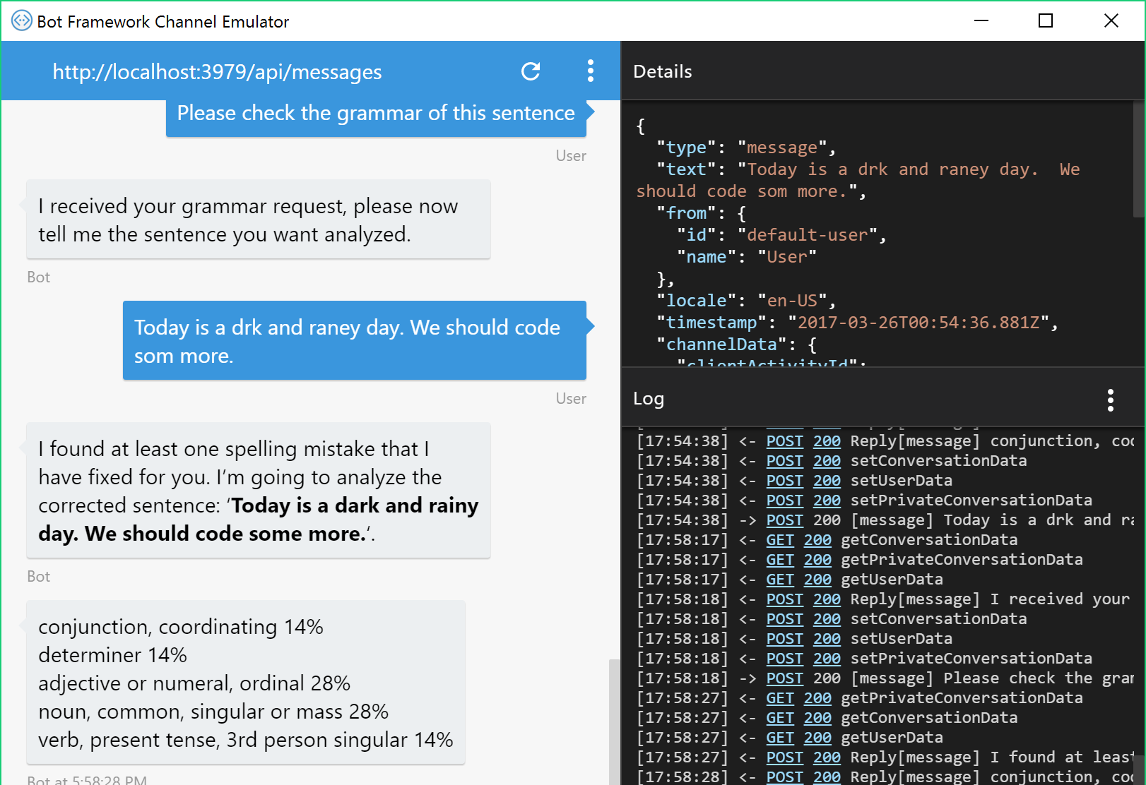
The Tools
Bot Framework SDK for .NET
Bot Framework SDK for node.js
Emulator
Azure (or any website) for hosting
Registration portal
Notes:
Let’s get started and look at the tools.
Microsoft provides the bot framework to help get started very quickly with bot development.
Using the Bot Framework SDK for .NET, you can built a bot that runs in the ASP.NET framework. It can run on your machine or be hosted in the cloud.
Equally there’s an SDK for node.js too, so you can host your bot in either of these frameworks to suit your skillset.
The Emulator is a tool which connects to your locally or cloud-hosted bot, providing a basic channel in which you can test your bot without it even needing to be registered.
When you are ready to publish your bot, Azure provides a highly available and scalable option for hosting, starting with free tiers. You can host both .NET and node.js bots there.
When you’re ready to present your bot to the world, you go to the registration portal where you declare your bot with a unique name and register the cloud-based end-point to which you published your bot. You also decide which channels will be available for users to use the bot.
We’re going to do all of this in the following demos.

Slide 4
Demo
Node.js bot
Notes:
Demo 2.1
Let’s see a basic bot running in Node.js locally

Slide 5
The ‘Proofing bot’
Initial prompt
Get input
Ask for sentence for Linguistic Analysis
Get input
Fix sentence with Bing Spell Check
Call LUIS
Call Linguistic Analysis
Provide result
Notes:
Now let’s see how LUIS is set up to be able to determine the user’s intent with the first intent.

Slide 6
The Cognitive Services
Vision | Speech | Language | Knowledge | Search
Computer Vision Content Moderator Emotion Face Video | Bing Speech Custom Speech Service Speaker Recognition | Bing Spell Check Language Understanding Linguistic Analysis Text Analytics Translator WebLM | Academic Entity Linking Knowledge Exploration QnA Maker Recommendations | Bing Autosuggest Bing Image Search Bing News Search Bing Video Search Bing Web Search
Notes:
LUIS is part of the Language APIs available within Cognitive Services.
We are focusing on these language APIs for this application.

Slide 7
Demo
Setting up LUIS
Notes:
Demo 2.2
Now let’s see how you get started with setting up LUIS to be able for use in things like your bot

Slide 8
The ‘Proofing bot’
Initial prompt
Get input
Ask for sentence for Linguistic Analysis
Get input
Fix sentence with Bing Spell Check
Call LUIS
Call Linguistic Analysis
Provide result
Notes:
Now we want to register for use of Bing Spell check and Linguistic Analysis to use in the application.

Slide 9
Demo
Add Cognitive Services
Notes:
Demo 2.3
Let’s add spell checking and linguistic analysis to our bot.

Slide 10
The ‘Proofing bot’
Initial prompt
Get input
Ask for sentence for Linguistic Analysis
Get input
Fix sentence with Bing Spell Check
Call LUIS
Call Linguistic Analysis
Ask for sentence for Text Analytics
Get input
Provide result
Call Linguistic Analysis
Provide result
Notes:
Now we want to add the second intent and then call Linguistic Analysis.

Slide 11
Demo
Sentimental Intent
Notes:
Demo 2.4
Now let’s add a second intent to LUIS which will let the bot know that we want to use Text Analytics to see the sentiment of a sentence

Slide 12
Demo
Registration & Publication
Notes:
Demo 2.5
Let’s get the app into the Cloud with Azure and register it as available for public use, through the basic webchat UI.

Slide 13
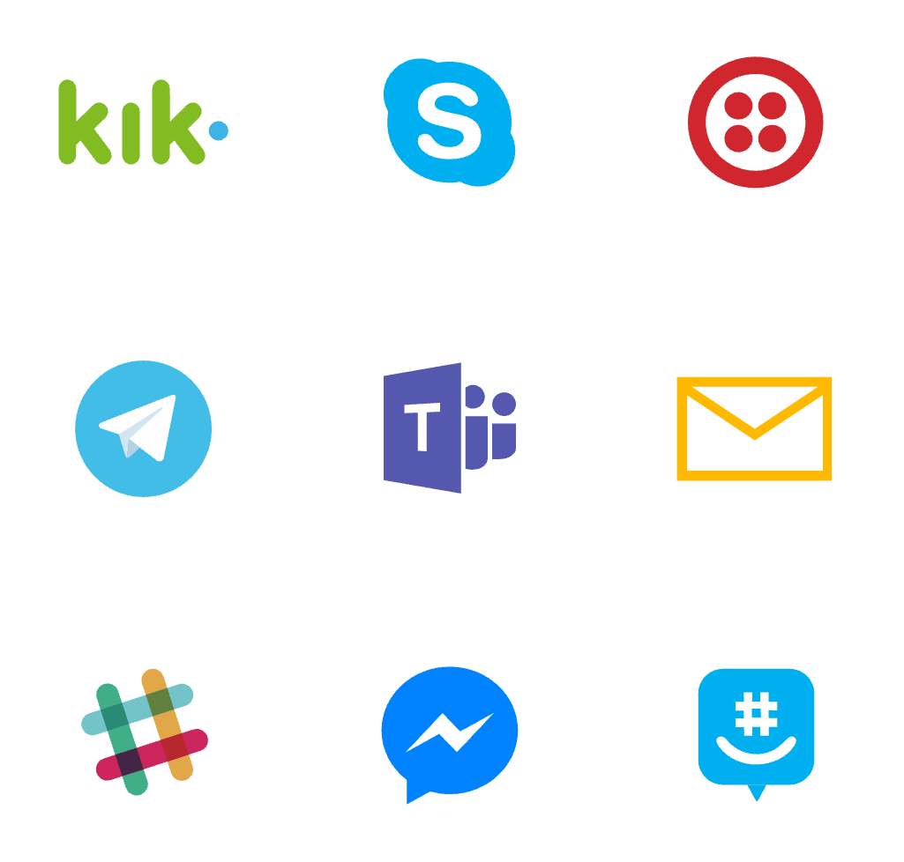
Where bots live
Notes:
Here’s a recap on the array of channel for bot participation.

Slide 14
Demo
Rich Responses
Notes:
Demo 2.6

Slide 15
Resources
Docs & getting started - https://dev.botframework.com/
Webchat control - https://github.com/Microsoft/BotFramework-WebChat
Learn and try Cognitive Services at - https://www.microsoft.com/cognitive-services
Notes:
As shown

